Slide 1
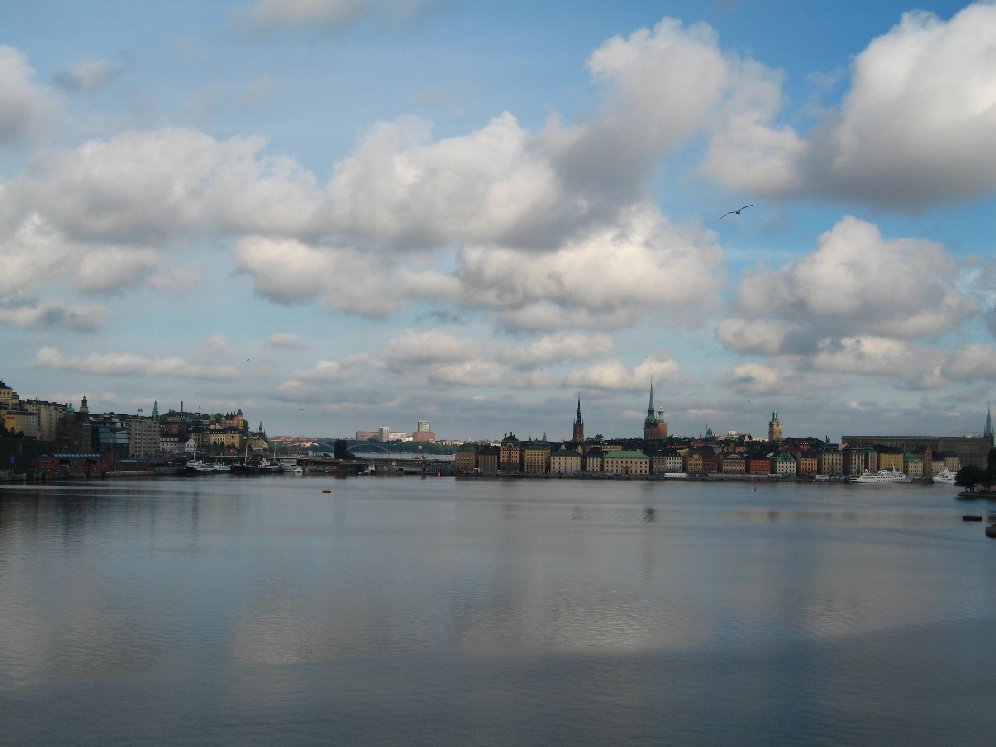
Mooring operation at Strömmen
For ships shorter than 230m
anchoring and mooring is still possible
Mooring
For mooring click on the blue mooring path
for anchoring green anchor path
Anchor

Slide 2
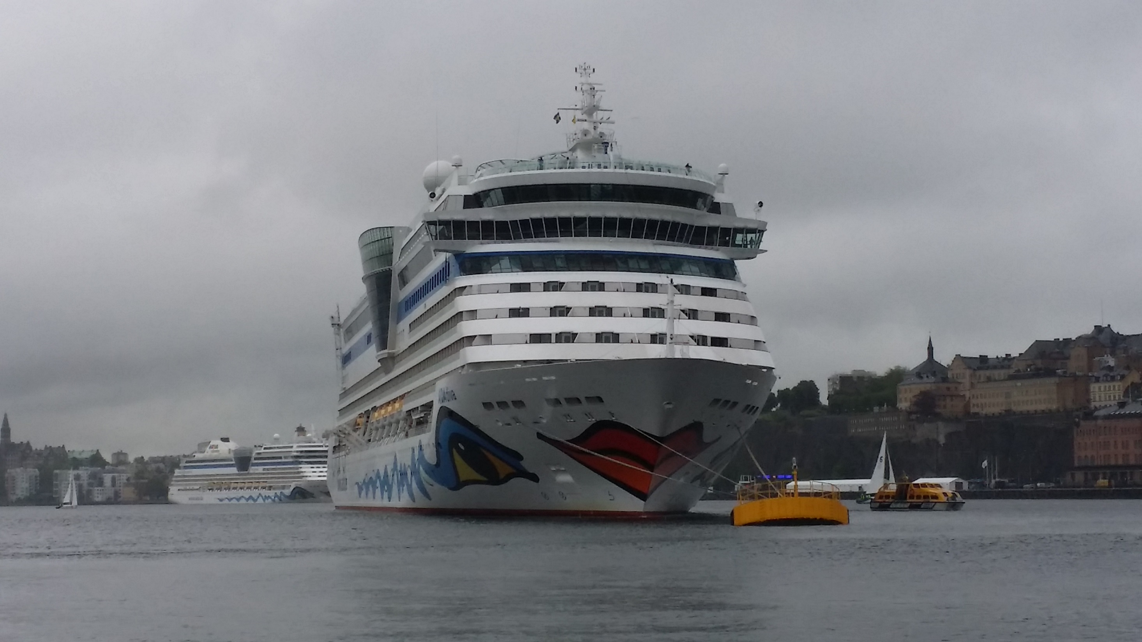
Mooring operation at Stockholm Ström

Slide 3
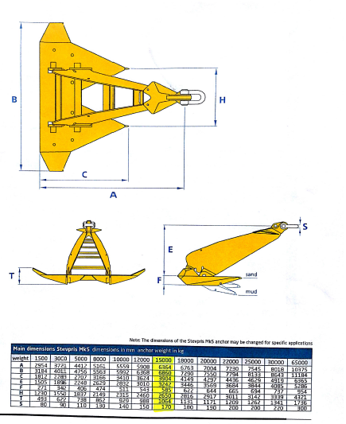
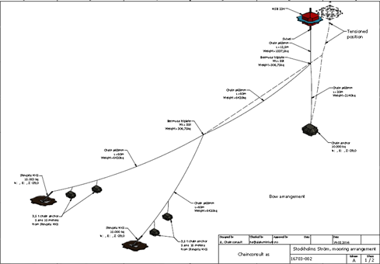
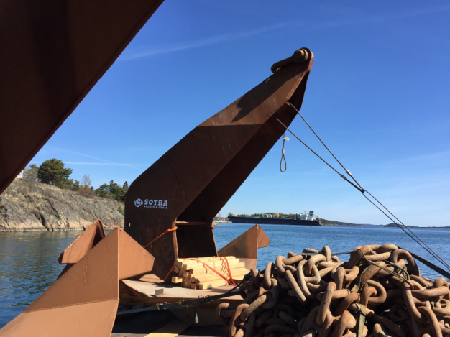
The anchor system is similar, as the offshore industry use for mooring in open waters
2 x ”MK5”-anchor,
weight of 15 tons each

Slide 4
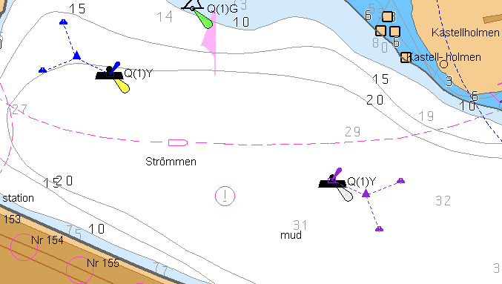
The blue and violett figurs show all of the anchors at Stockholms Ström

Slide 5
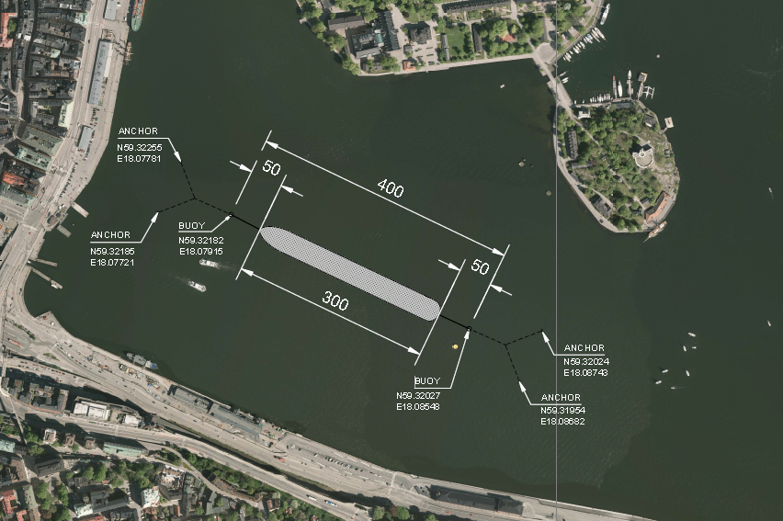
There is ~ 10 m slack in the chain for each buoy
which means that the distance between buoys will
be ~380m after the lines has been tightened

Slide 6
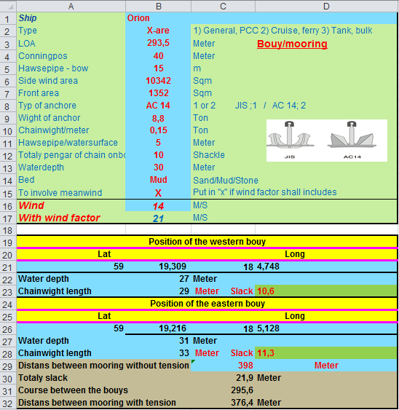
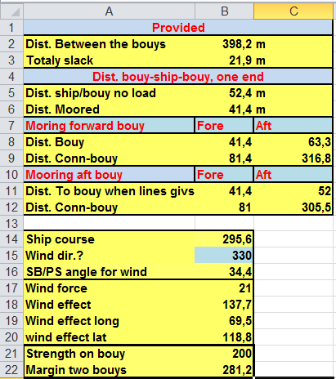
The system is designed for mean winds up to 14 m/s in all
directions for a ship with a wind area of 10 000 sqm

Slide 7
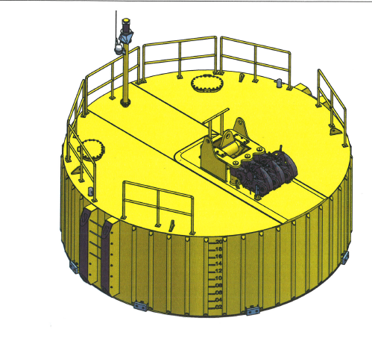
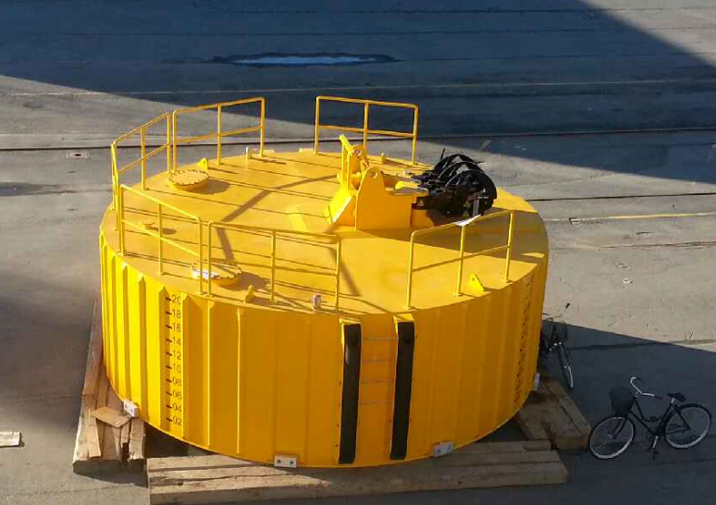
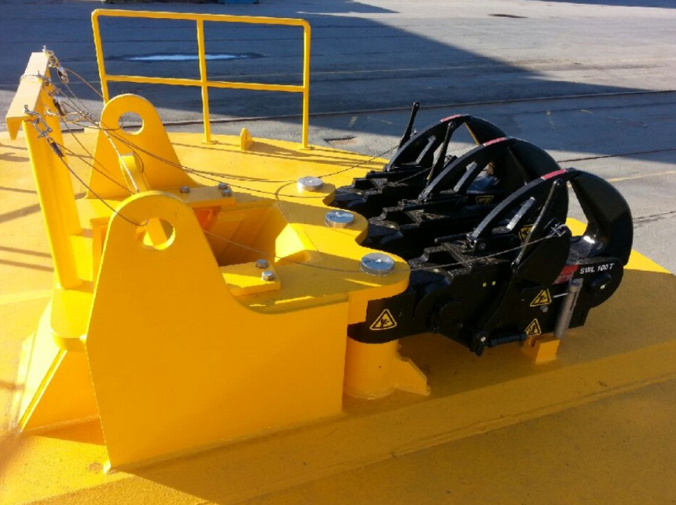
Maximum 6 lines can be used for mooring at the
western buoy and 8 lines at the eastern buoy
The buoys are equipped with AIS and quick release hooks (SWL 125 ton)
The anchor chain is the limitation for the buoy
maximum work load for the buoy is 269 tons, break load 383 ton

Slide 8
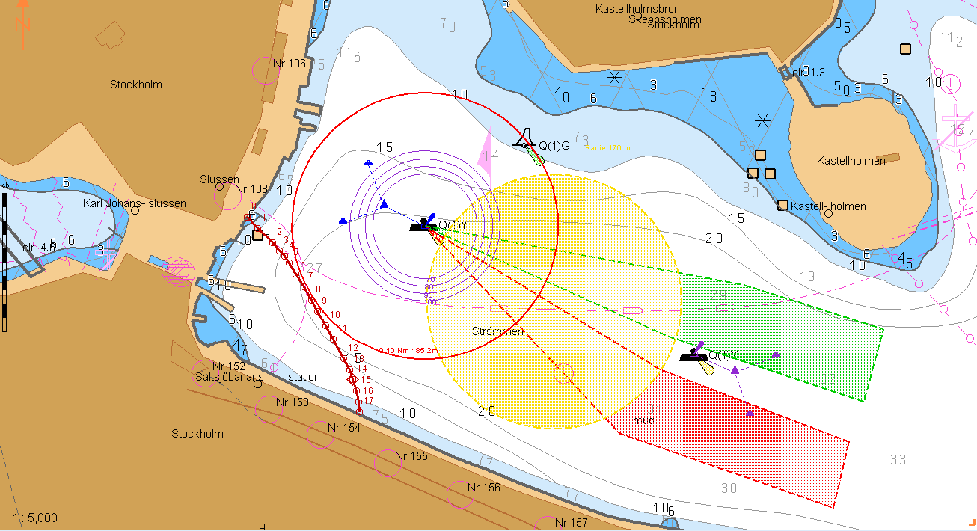
Stockholm Port do not have any restrictions for bow out or in.
Its up to the ship to determine, but its appreciates
if the ship will moor with the bow in
Its possible to approach north or south of the eastern mooring buoy

Slide 9
If, mooring with the bow out, the yellowed marked area have an diameter of 340 m

Slide 10
There is one mooring boat
It is recommended to start with the moorings to the forward buoy
Before passing the eastern mooring buoy
make fast the tug boat, tug line

Slide 11
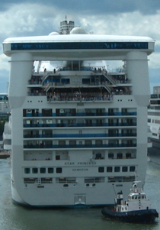
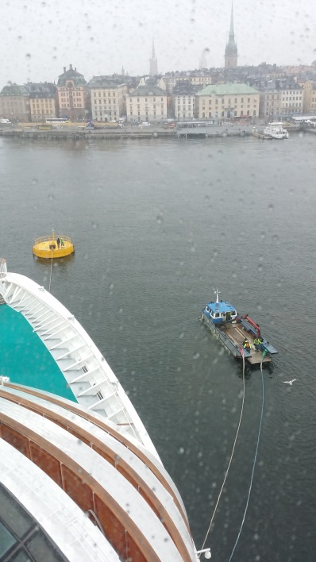
-just drop the lines, no heaving line required
The mooring boat will avoid working under tight lines
and can handle two lines

Slide 12
Before all lines are tight and fast the ship will
swing for a while.
It is important to give this operation some time
and adjust the lines so bow and stern lines will be tightened

Slide 13
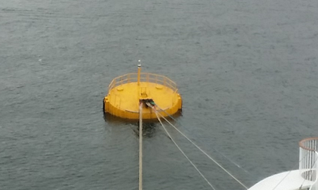
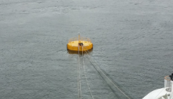
On departure, slack lines so that
the linesmen safely can embark the bouy
Dont let go more lines than the crew can bring in,
to aviod any problems with lines in the propellers etc

Slide 14
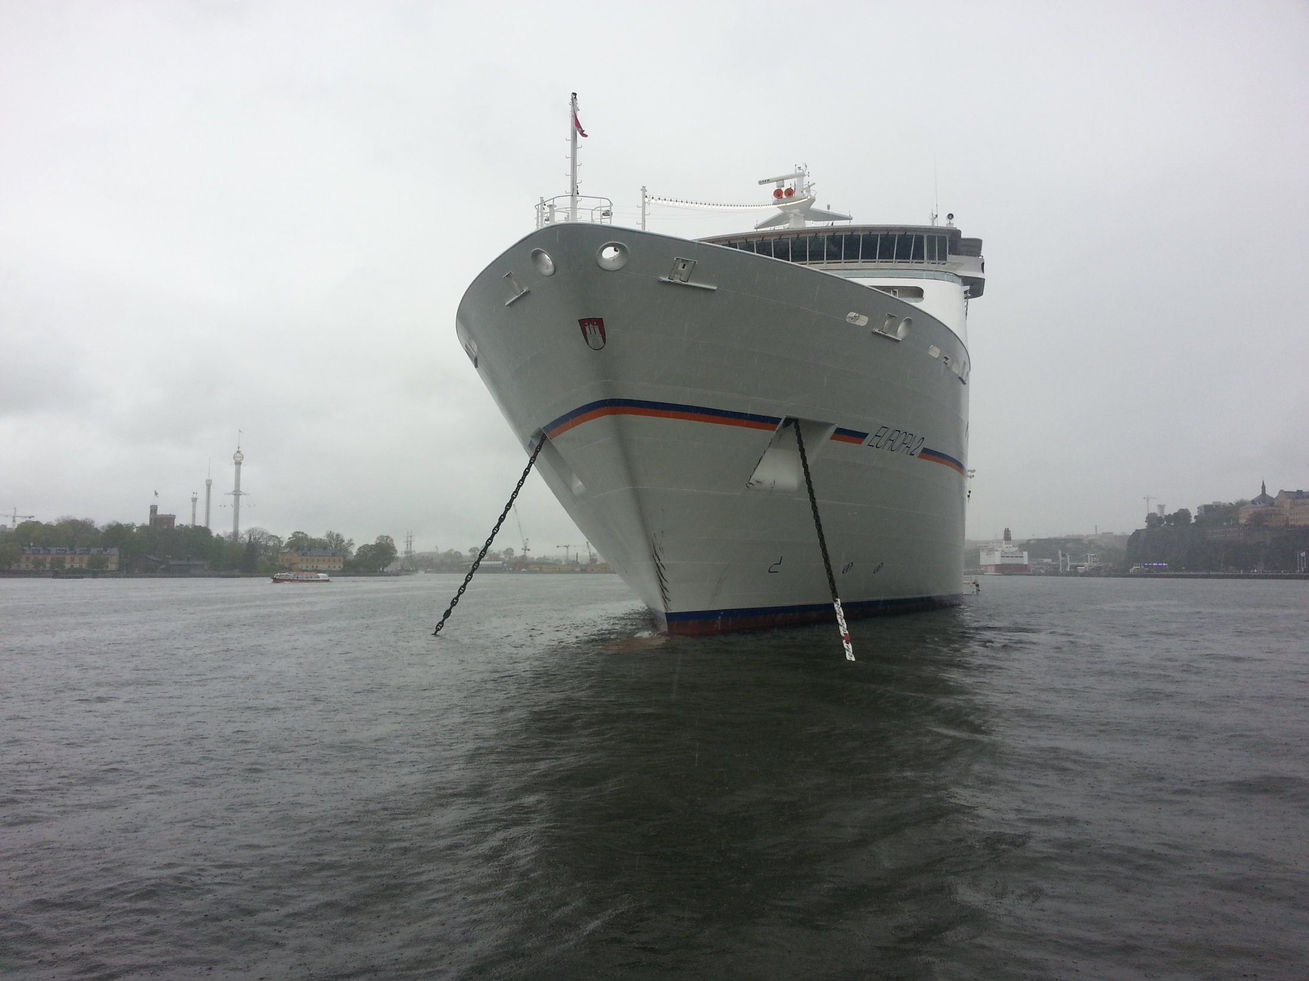
Anchor and buoy mooring at Stockholm ström

Slide 15
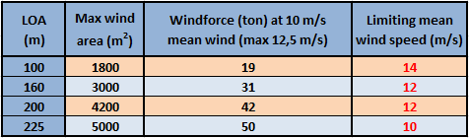
Wind restrictions anchoring at Strömmen

Slide 16
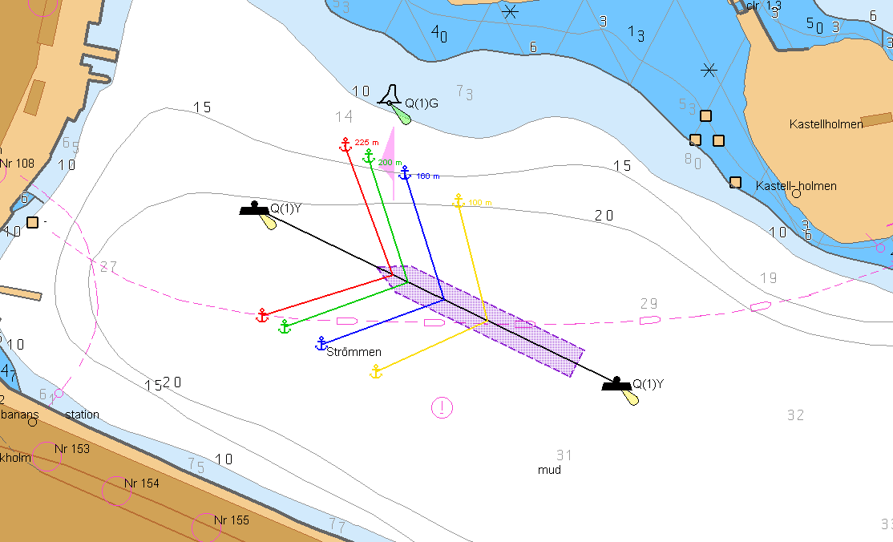
The positions for the anchors are calculated
from the mooring buoys position in the chart
and can be presented in the chart and/or given to the
mooring boat for an optical heading

Slide 17
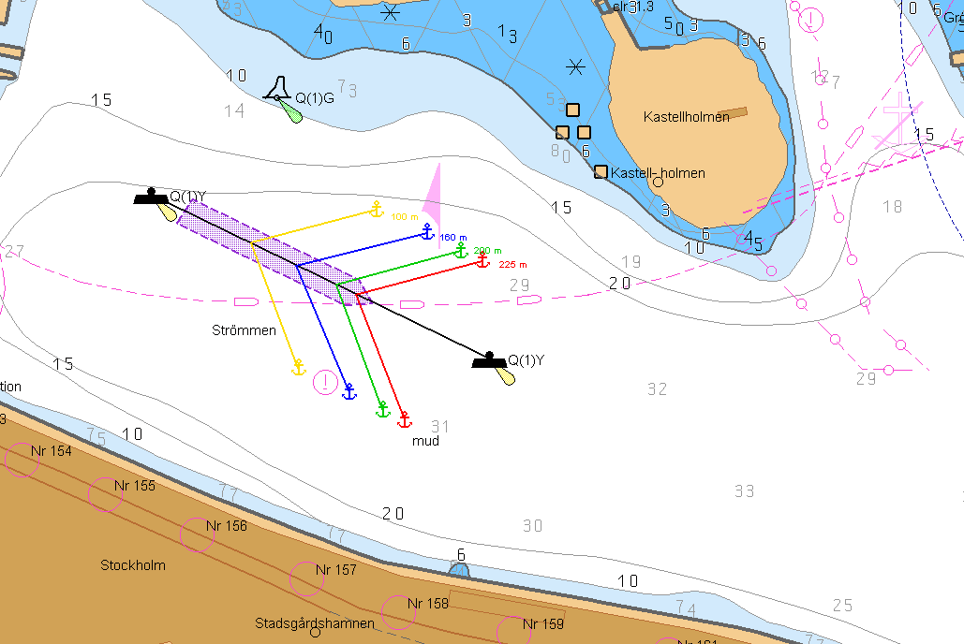
It´s possible to use western or

Slide 18
- estern mooring buoys, but only between the two buoys

Slide 19
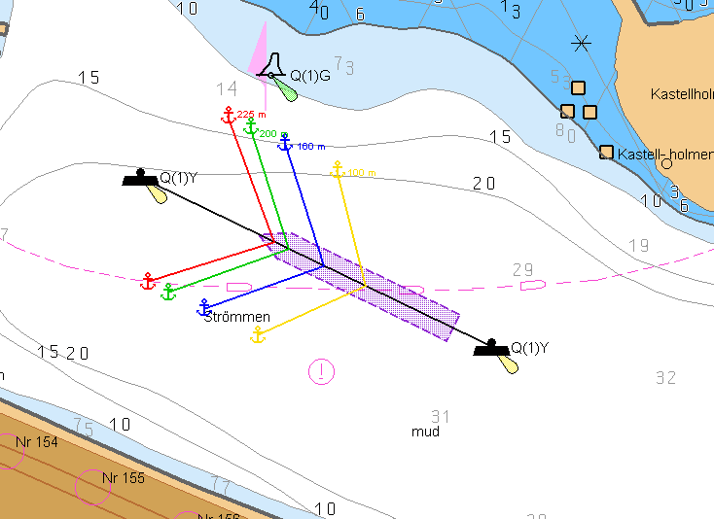
At certain wind and current conditions, the ship drift southward during the approach
Connect the tugboat aft with tugs line

Slide 20
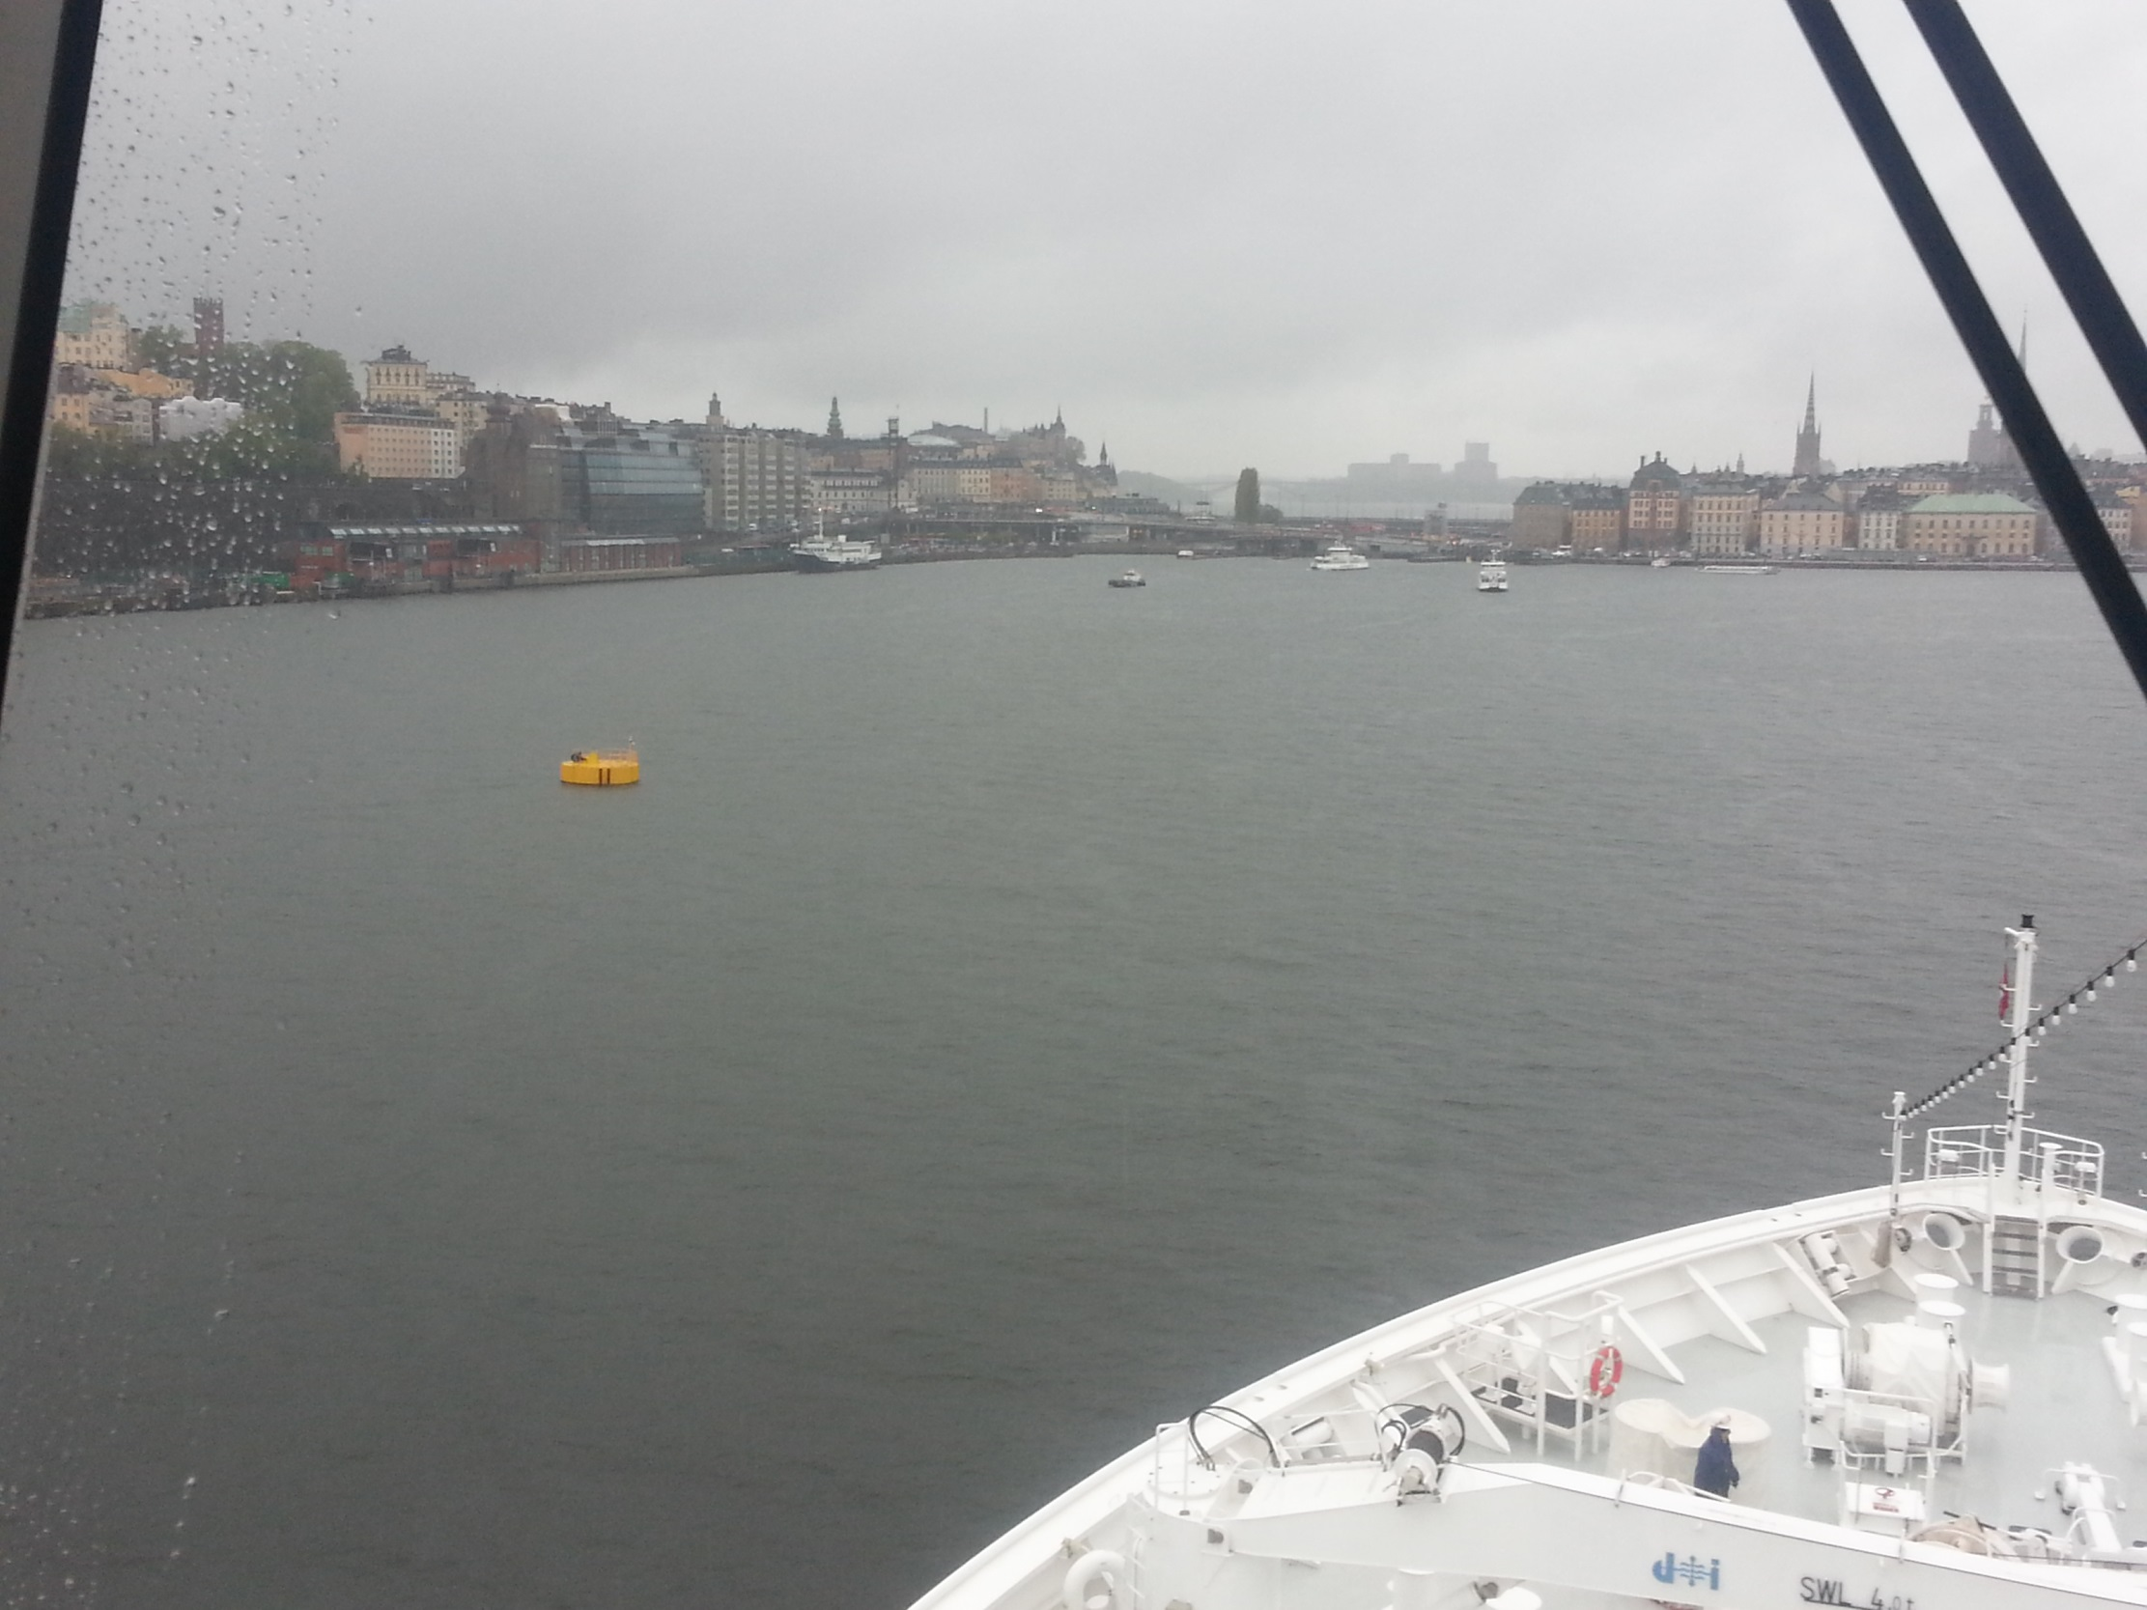
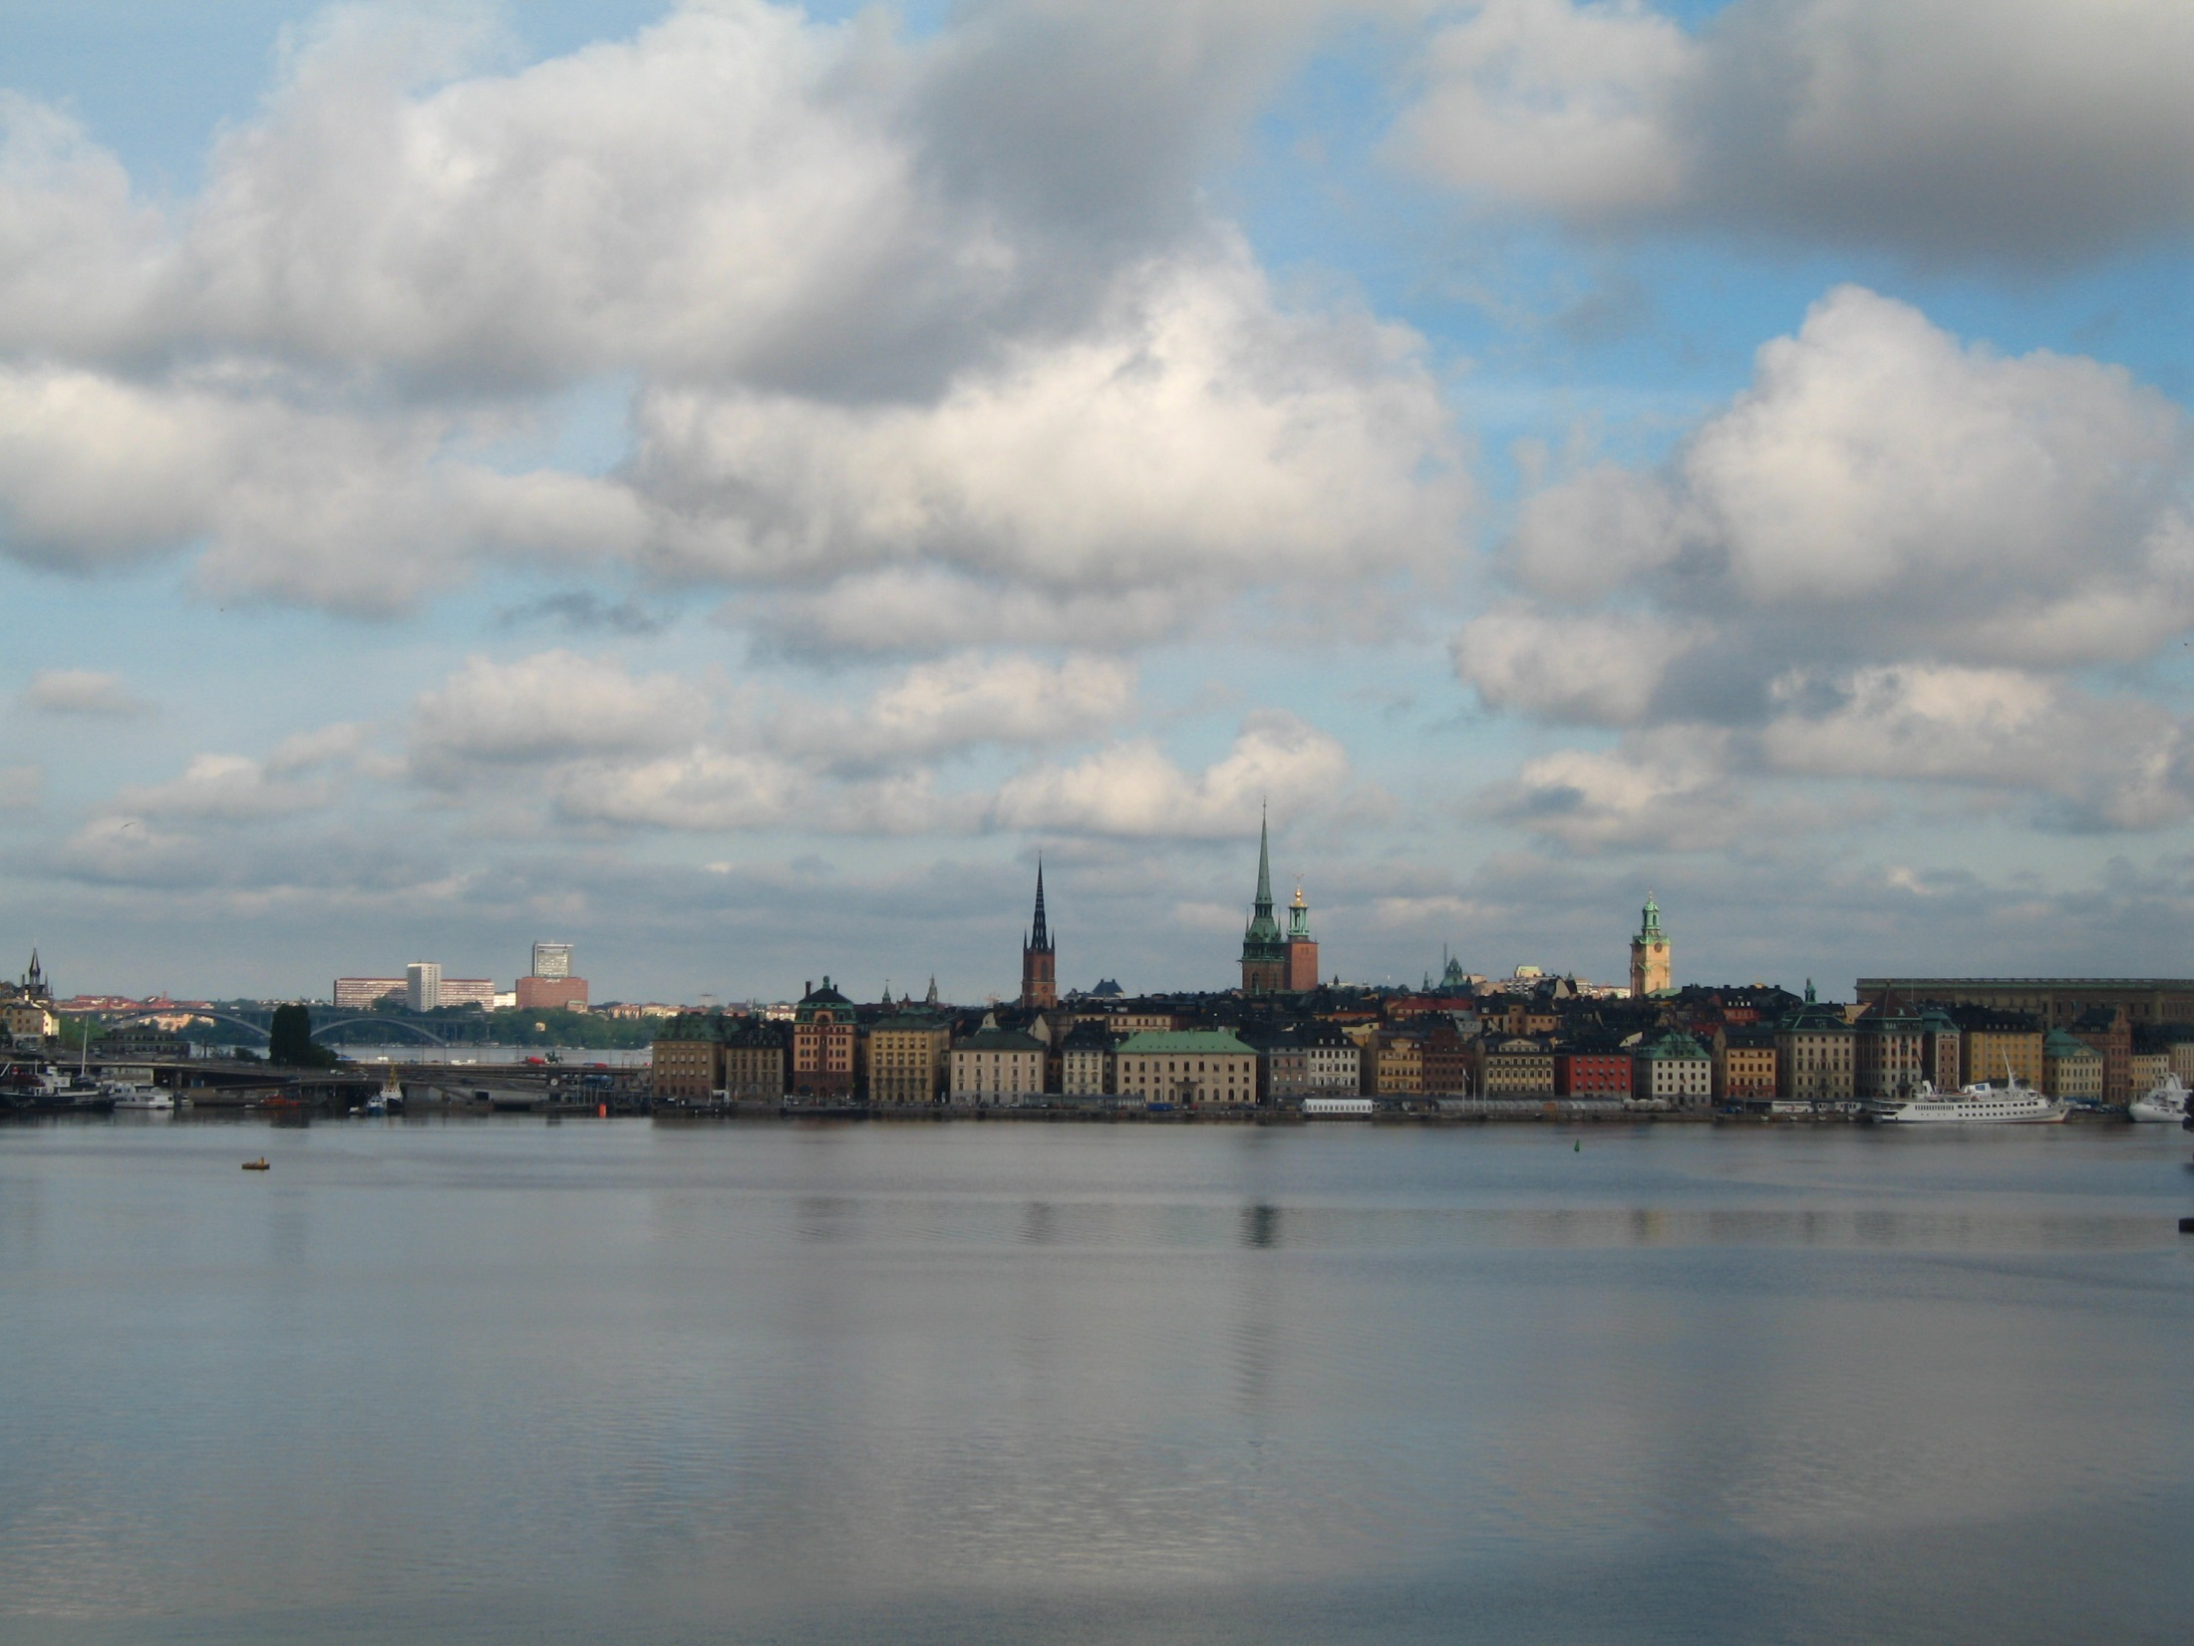
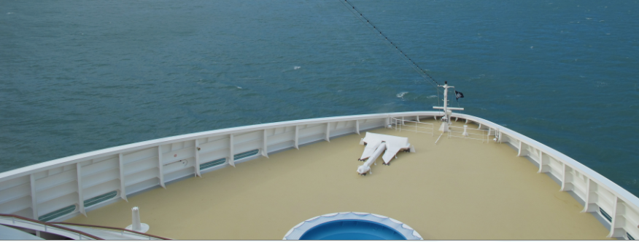
Use the mooringboat for an optical heading to the dropping position.

Slide 21
Manoeuver towards the mooringboat
Before the anchor drops, the mooringboat will move towards the other anchor position

Slide 22
After the first anchor has been dropped, move the ship to the other anchor position.
7.5 shackles will be used to reach second anchor position.

Slide 23
Before the second anchor drops, the mooring boat will move to the mooring buoy.
When the other anchor has been dropped, the tugboat will assist/tow the ship
towards the mooring buoy
Max two lines at the same time for the mooringboat

Slide 24
Maximum 6 lines can be used for mooring on the
western buoy and 8 lines at the eastern buoy
The buoy is equipped with AIS and quick release hooks
The anchor chain is the limitation for the buoy
maximum work load for the buoy is 269 tons, break load 383 ton

Slide 25
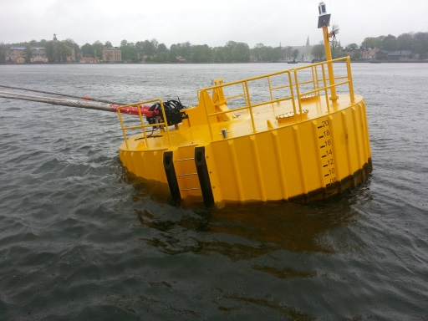
Well moored at Strömmen
5 Schackels
5 Schackels
Distance buoy – Ship 30-40m
Drift of buoy ~10 m
The bouy will pitch
when the lines are tighted

